Slide 1
Using version control and git
A lab book for your code

Slide 2
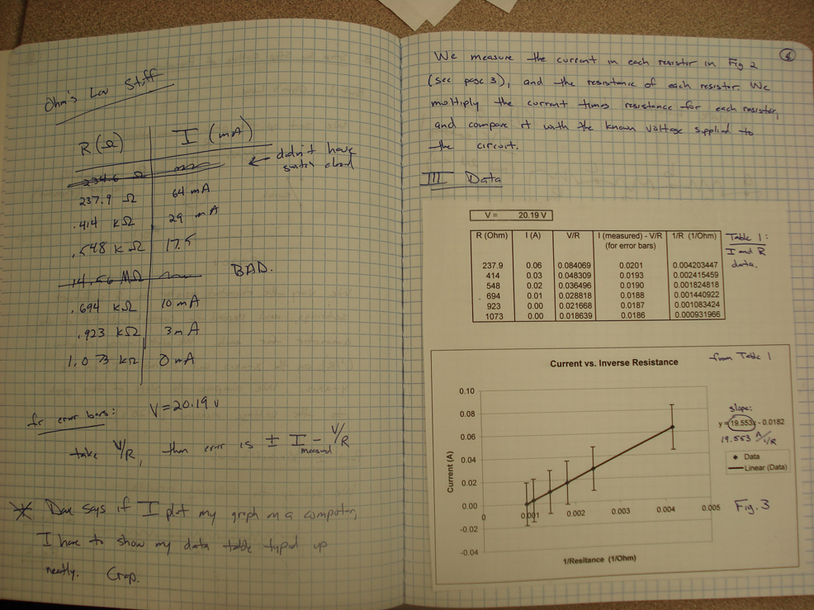
The lab book has many purposes:
Reminds you of what you’ve done
Lets you go back to change something that went wrong
Lets other people reproduce your work or pick up where you left off
Serves as proof that the work was done
Why do many people stop when it comes to writing code?

Slide 3
The lab book has many purposes:
Reminds you of what you’ve done
Lets you go back to change something that went wrong
Lets other people reproduce your work or pick up where you left off
Serves as proof that the work was done
Why do many people stop when it comes to writing code?

Slide 4
Keeping track of changes in your analyses
When working in R (or Matlab, or Mathematica, or ….etc.) you generally save code as scripts
How do we keep a lab book for our code?

Slide 5
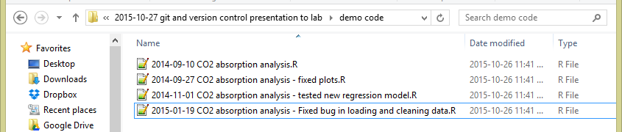
1. Keep each version of a file as you change it
Pros: keeps each version of your code, so you can recreate it if something doesn’t work
Cons: Adds up to a lot of extra files. Really easy to forget to save a new version, or end up with “version_1_clean”, “version_1_better”, “version_2_cleaned_again” ….

Slide 6
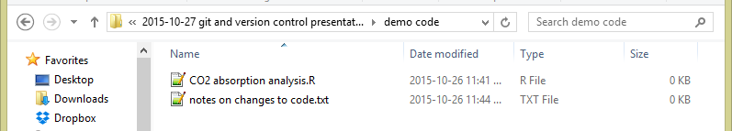
2. Keep notes on changes as a separate file (or as a paper lab book)
Pros: Keeps your folder clean (each file does a specific thing). Notebook will keep track of why you made each change over time
Cons: You can never go back and recreate an old analysis. Really easy to forgot to write a change down in your lab book…

Slide 7
3. Best of both worlds: Software version control
Keeps track of:
What files have changed over time, and what the changes are
What files have changed that have yet to be stored
Lets you:
Keep detailed notes on why you made each change
Revert back to old versions of code if needed
Try experimental changes without risking code that works
Share your code and history of changes easily

Slide 8

What is , and why use it?
One type of version control software (likely the most popular), invited in 2005
Free and open source
Easy to set up on a personal computer
Lot of great support tools (including support within Rstudio) and a huge and helpful user base
Can put things on GitHub (more about this at the end)

Slide 9
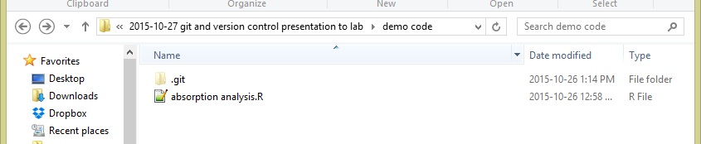
What is , and why use it?

Slide 10
What I’ll cover today:
How to set up a git repository for a project (the “lab book”)
Tracking files with commits and comments
Slightly more advanced (if I have time):
Going back in time with branches
ignoring files

Slide 11
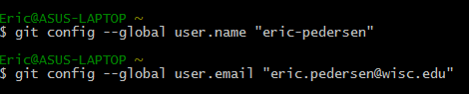
Setting up git
Open up a command terminal and type in the following two lines (using your own name and email):

Slide 12
The first basic process: creating a repository
File_1
File_1
File_2
File_2
.git folder
Project folder
This tells git to keep track of what’s changed in this folder

Slide 13
The second basic process: Staging and committing
Modified
Untracked
staged
Unmodified
Notes:
Untracked: new files that have been added
Staged: can hold as many file

Slide 14
The second basic process: Staging and committing
Modified
add
Untracked
staged
add
You change
some files
commit
Remove the file
Unmodified

Slide 15
The second basic process: Staging and committing
Modified
Untracked
staged
File_1
add
File_2
git -add “File_1” “File_2”
Unmodified

Slide 16
The second basic process: Staging and committing
Modified
Untracked
staged
File_1
File_2
commit
git commit –m “my first commit. Hello World”
Unmodified

Slide 17
The second basic process: Staging and committing
Modified
Untracked
staged
Commit 1:
“My first commit. Hello world.”
File_1
File_2
Unmodified

Slide 18
The second basic process: Staging and committing
Modified
File_1
Untracked
staged
File_3
You change
some files
File_2
Unmodified

Slide 19
The second basic process: Staging and committing
Modified
File_1
Untracked
staged
add
File_3
File_2
git -add “File_3”
Unmodified

Slide 20
The second basic process: Staging and committing
Modified
File_1
Untracked
staged
commit
File_2
File_3
git commit –m “Added data File_3”
Unmodified

Slide 21
The second basic process: Staging and committing
Modified
stage
Untracked
staged
File_1
File_2
File_3
Unmodified

Slide 22
The second basic process: Staging and committing
Modified
Untracked
staged
commit
File_1
Commit 3:
“Fixed a bug in File_1.”
File_2
File_3
Unmodified

Slide 23
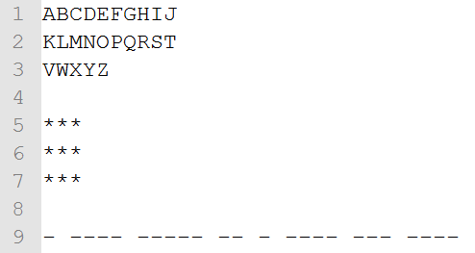
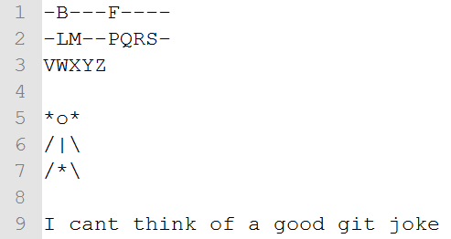
Practicing git: A game of hangman
With a partner: play Hangman, tracking each change of the game
Initial setup
Final game

Slide 24
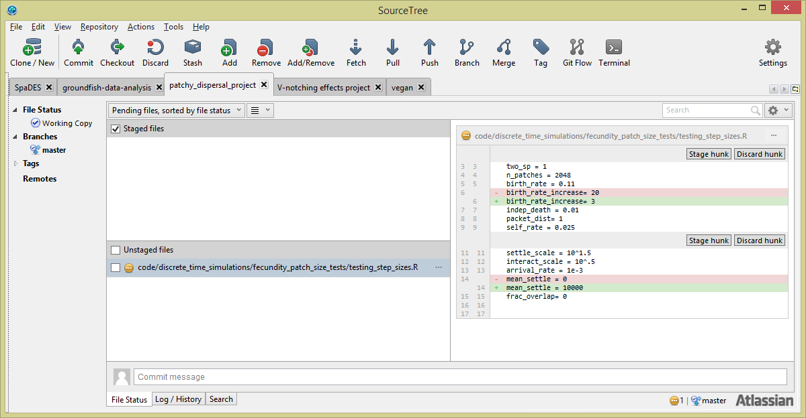
projects
Staged files
Unstaged
modified or untracked files
Differences between selected modified file
And last commited version
Where you add your commit message

Slide 25
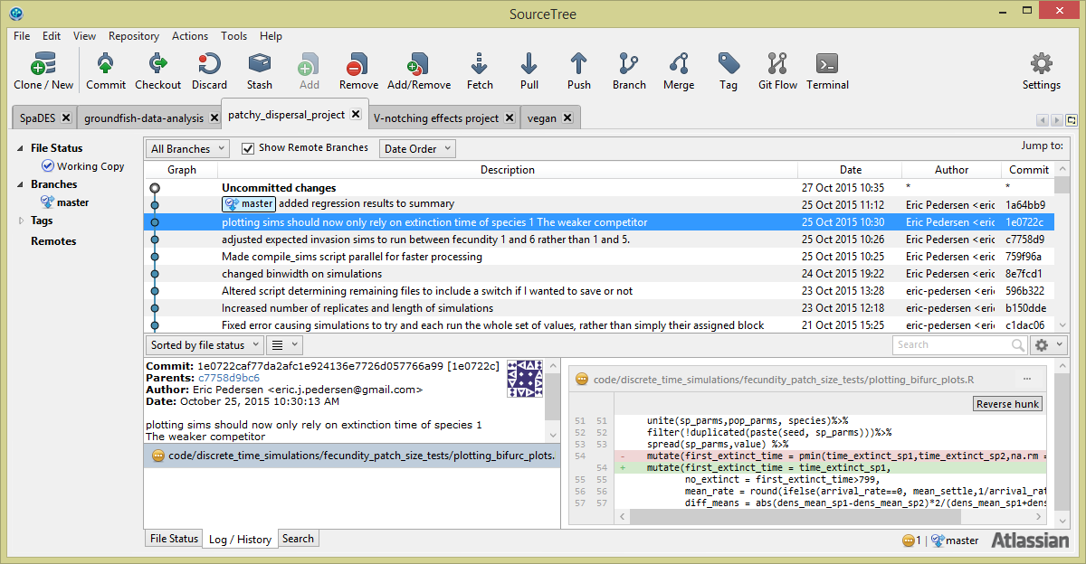
History of commits
Changes made to the selected file
in that commit
Commit message and
files in the commit

Slide 26
Further resources:
The git webpage has pretty extensive manuals and tutorials on these and more advanced concepts, as does Atlassian, SourceTree’s maker:
https://git-scm.com/documentation
https://www.atlassian.com/git/tutorials/
Software Carpentry has a great tutorial:
https://swcarpentry.github.io/git-novice/
Social media (Stack Overflow, or Twitter)
e.g.: https://twitter.com/ericJpedersen/status/658719435004473344
When things (inevitably) go wrong:
http://ohshitgit.com/

Slide 27
Git tips
All the files you want to track need to be in one directory (but they can be in nested directories in that one)
Start by creating a repository for a project
Commit files early and often, in small batches
Use informative commit messages
Use branches to test new ideas
Git isn’t a backup! Always keep your backups up to date
Git will keep a copy of every form of the file you remember to stage and commit, unless you actively work to delete it. (It’s good at compression and avoiding duplication though). Use a .gitignore file if you have temporary files that you don’t want to track.
To share code, you can zip the directory and email it, or upload it to Github: both ways, your collaborator can see everything you’ve tried

